Slide 1
UE19CS390A – Capstone Project Review #2
(Project Requirements Specification and Literature Survey)
Project Title :Recipe Recommendation Based On Ingredients Recognition Using CV AND ML(RRIR)
Project ID :14
Project Guide :Prof Swati Pratap Jagdale
Project Team :A R Manyatha
Amulya Dinesh
Manasi Swain
Mihir Soni

Slide 2
Outline
Abstract
Motivation Scope of the Project
Suggestions from Review – 1
Functional and Non - Functional Requirements
Literature Survey
Capstone (Phase-I & Phase-II) Project Timeline
Conclusion
References

Slide 3
Abstract
We will be creating a recipe recommendation system using pictures/videos of the pantry for a variety of uses mainly being to help out working individuals to prep their meals without having to spend too much effort or time in eating healthy.

Slide 4
Motivation and Scope of the Project
Work, kids, new opportunities, those are often the priority. Healthy eating becomes a secondary concern in your life. So your run down to the cafeteria, may solve the food problem but eventually it takes its toll on your health, either through weight gain, lost energy, or both.
Our system will help overcome this issue, by providing simple recipes which can be made by using ingredients available in the pantry as home cooked meals are proven to be nutritious and healthy.

Slide 5
Suggestions from Review – 1
To provide calories along with recipe
Enrich dataset
Dietary constraint (diabetics, vegetarian, vegan, etc)
Explored on datasets containing recipes with nutritional value
(https://www.kaggle.com/elisaxxygao/foodrecsysv1?select=core-data_recipe.csv)
https://www.kaggle.com/takuyaishii/recipe-preprocessing/data)

Slide 6
User Classes and Characteristics
Users of the system should be able to retrieve recipes with nutrition value, on uploading the images of ingredients from the database. The following are the target user class of our application:
People who want to learn how to cook
People who want to try new recipes
People who are not sure what to cook based on the available ingredients
Inspires new ideas and activities in the kitchen for new cooks, busy parents, foodies, and pro chefs alike.

Slide 7
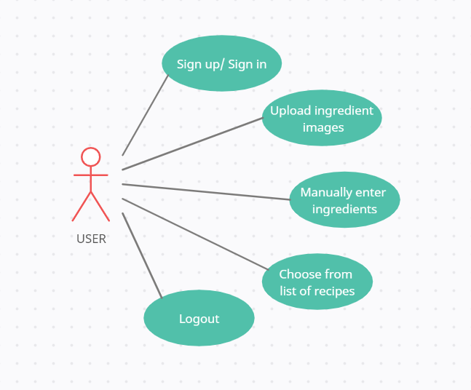
User Classes and Characteristics

Slide 8
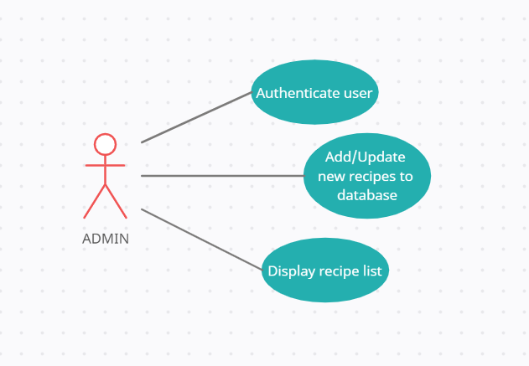
User Classes and Characteristics

Slide 9
Constraints / Dependencies / Assumptions / Risks
Hardware limitations:
low camera quality
low lighting (bad quality captured)
Storage limitation of the server
Risks:
Failure to remove essential bugs
Unable to upload photos to the server
Unable to keep server up and running
ML model might take time to process the images

Slide 10
Constraints / Dependencies / Assumptions / Risks
The images/videos sent by the user will be clear enough to process.
The model will not take too long to process the input and give a valid output to count as real-time.
There will never be more than a certain number of users at a time connecting to the server (no server down-time).

Slide 11
Constraints / Dependencies / Assumptions / Risks
Failure to remove essential bugs
Unable to upload photos to the server
Unable to keep server up and running
ML model might take time to process the images

Slide 12
Functional Requirements
Validity tests on inputs : Thorough preprocessing will be done to ensure that the datasets are clean and the pictures/videos sent by the user will be tested against the model.
Sequence of operations : First the user will take pictures/videos and upload it into our web-app. Then our cv model will take that as an input to extract data points. These data points will be taken as input for the model which will output the recipe to print it to the user.

Slide 13
Functional Requirements
Error handling and recovery : If the images/videos get lost in transit, then we will ask the user to resend the files.
Consequences of parameters : The images will be processed and labeling will be done accordingly. This is then fed to the algorithm and desired output is generated.
Relationship of outputs to inputs : Input will be given to the CV model by the user which will output to the ML model which will output the final answer to the users mobile app.

Slide 14
Non - Functional Requirements
Performance Requirement:
Availability: The server should be available on specified time as many users are waiting for the recipe to be generated .
Correctness: Accurate recipes should be recommended to the user in real time.
Maintainability: The administrators should ensure that the server is up and running and not overloaded, ensuring it is well maintained.
Usability: The model should handle multiple requests from multiple users.

Slide 15
Non - Functional Requirements
Safety Requirements:
If there is extensive damage to a wide portion of the database due to catastrophic failure, such as a disk crash, the recovery method restores a past copy of the database that was backed up to archival storage (typically tape) and reconstructs a more current state by reapplying or redoing the operations of committed transactions from the backed up log, up to the time of failure.

Slide 16
Non - Functional Requirements
Security Requirements
Authentication of user whenever he/she logs into the system.
The users will have private user profiles which will store data of the the recipes that they’ve used from our application previously on a MongoDB server which will be kept hidden from the public.
MongoDB has a multitude of security features, such as encryption, authentication, role-based access control, TLS/SSL encryption and many more.

Slide 17
Non - Functional Requirements
Other Requirements:
The model requires a server with high speed internet capability.
The user should be equipped with fair network bandwidth to send images and receive recipes.
The system will be designed to be highly scalable, ie, it will be able to process a wide range of ingredients efficiently.

Slide 18
Literature Survey
Paper Details | Objective of paper, Techniques/Methods | Advantages | Limitations
Lili Pan, Samira Pouyanfar, Hao Chen, Jiaohua Qin, Shu-Ching Chen, “DeepFood: Automatic Multi-Class Classification of Food Ingredients Using Deep Learning”, 2017 | First, an overview of the state-of-the-art research in food detection and CNNs is provided in section. Presents the details of the proposed multi-class food classification. Analyzes the experimental results on three different CNN models. | Accuracy comparison between different deep learning and feature selection methods is done | Complicated system with large overhead

Slide 19
Literature Survey
Paper Details | Objective of paper, Techniques/Methods | Advantages | Limitations
Alkatai Gholve , Nidhi Mishra, Revati Gaikwad, Shruti Patil. “Recipe Recommendation System”, 2019 | For this developing object detection app, TensorFlow API and Cumulative Knowledge-based Regression Models (CKRM) are used. | The proposed system features a low computation cost and confidentiality of the training set. | Small training dataset.

Slide 20
Literature Survey
Paper Details | Objective of paper, Techniques/Methods | Advantages | Limitations
Mona Mishra, Yifan Gong, “Recipe Recommender System Using Image Recognition of Food Ingredients”, 2018 | Image processing, Machine learning, Recommendation system, SVM, 5-layer convolution neural network and ResNet50. Models used are SVM, a 5-layer convolutional neural network and ResNet50 provided by Keras library. | User friendly interface, low overhead. | We found that as we increased the number of categories of the food ingredients, the accuracy dropped significantly.

Slide 21
Literature Survey
Paper Details | Objective of paper, Techniques/Methods | Advantages | Limitations
Gangothri R. Sanil , Anusha Anchan , Vijetha Achar, Kavya Hegde, “KNN based Recipe Retrieval using Ingredient Recognition”, 2018 | Advent a Cooking Recipe Retrieval System with the recognition of food ingredients, which helps us to search for cooking recipes either by Image or Name. Feature Extraction of selected images is carried out by HARRIS and SIFT. Comparison of data of selected image with the trained data by using KNN Algorithm. | Simple UI in the form of a mobile application. High accuracy. | Should improve the object recognition, recipe recommendation functionalities

Slide 22
Literature Survey
Paper Details | Objective of paper, Techniques/Methods | Advantages | Limitations
Yudong Zhang,Shuihua Wang, Genlin Ji, Reetha Phillips, “Fruit Classification using Computer Vision and Feedforward Neural Network”, 2015 | Proposed a hybrid feature set, containing color information, texture information, and shape information. Introduced a stratified k-fold cross validation to avoid overfitting. The FSCABC algorithm, and employed it to the training of FNN. Compare it with other algorithms. | Creation and usage of own dataset,which is customized for the required project. | Limited to whole fruits and not diced, frozen or canned fruits.

Slide 23
Literature Survey
Paper Details | Objective of paper, Techniques/Methods | Advantages | Limitations
Horea Muresan, Mihai Oltean, “Fruit recognition from images using deep learning” , 2020 | Convolutional neural network is used for detecting fruits. For implementing, training and testing the network TensorFlow library which includes the features of Keras framework was used. The neural network was trained using different levels of data augmentation and preprocessing. | Image recognition to detect fruits by considering the structure of images to categorize them efficiently. | Dataset containing less variety of ingredients, no real time analysis of food ingredients.

Slide 24
Literature Survey
Paper Details | Objective of paper, Techniques/Methods | Advantages | Limitations
Frida Femling, Adam Olsson, Fernando Alonso-Fernandez, “Fruit and Vegetable Identification Using Machine Learning for Retail Applications”, 2018 | Evaluated two Convolutional Neural Network architectures (Inception and MobileNet), as classifiers of 10 different kinds of fruits or vegetables. Images for the classifier are provided by a Raspberry Pi Camera Module v2, connected to a Raspberry Pi. | Dataset includes images from existing dataset and self collected images. Good accuracy. | Uses extra hardware components like Raspberry pi.

Slide 25
Literature Survey
Paper Details | Objective of paper, Techniques/Methods | Advantages | Limitations
Keiji Yanai, Takuma Maruyama, Yoshiyuki Kawano, “A Cooking Recipe Recommendation System with Visual Recognition of Food Ingredients”, 2014 | This system uses color-histogram and bag-of-features with SURF extracted from multiple frames as an image representation and a linear kernel SVM as a classifier. By pointing a mobile camera towards food ingredients, a user receives a recommendation list. | The model used in this paper helps users to cook recipes based on the ingredients found in grocery stores or kitchen. | Improvement of the user interface, considering the amount, nutrition and prices of ingredients

Slide 26
Literature Survey
Supporting and against the particular hypothesis.
Supporting: Our hypothesis enables easy to understand and effective flow of data using machine learning and CV that gives an apt result to a query given by the user without having to put it into words. It is the epitome of autonomy and ease-of access.
Against: A possible downside to our hypothesis may be overloading the server.

Slide 27
Literature Survey
Alternative hypothesis:
An alternate hypothesis would be to have the user manually enter the ingredients into the app/web-app. This would be a lot lighter on the server as no pictures/videos will be involved. However, this wouldn’t be as convenient for the user as compared to our hypothesis so we won’t be going for this.

Slide 28
Discussion
Advantages
Accuracy comparison between different deep learning and feature selection methods is done
The proposed system features a low computation cost and confidentiality of the training set.
Creation and usage of own dataset,which is customized for the required project.
Image recognition to detect fruits by considering the structure of images to categorize them efficiently.
Dataset includes images from existing dataset and self collected images, gives good accuracy.
The model used helps users to cook recipes based on the ingredients found in grocery stores or kitchen.

Slide 29
Discussion
Disadvantages:
Complicated system with large overhead
Small training dataset.
With increased number of categories of the food ingredients, the accuracy drops significantly.
Should improve the object recognition, recipe recommendation functionalities
Limited to whole fruits and not diced, frozen or canned fruits.
Dataset containing less variety of ingredients, no real time analysis of food ingredients.
Improvement of the user interface, considering the amount, nutrition and prices of ingredients

Slide 30
Any other information
We are tentatively going to implement this project using mobile application.
Future scope is converting this project to an android application.

Slide 31
Summary of Literature Survey
The models used to implement the problem statements in the papers mainly include:
Feature extraction : Deep learning models such as CNN , FNN etc
Feature selection : PCA (Principal Component Analysis), CFS (Correlation Feature Selection), IG (Information Gain)
Feature classification : Non linear SVM kernals, Cumulative Knowledge-based Regression Models (CKRM)

Slide 32
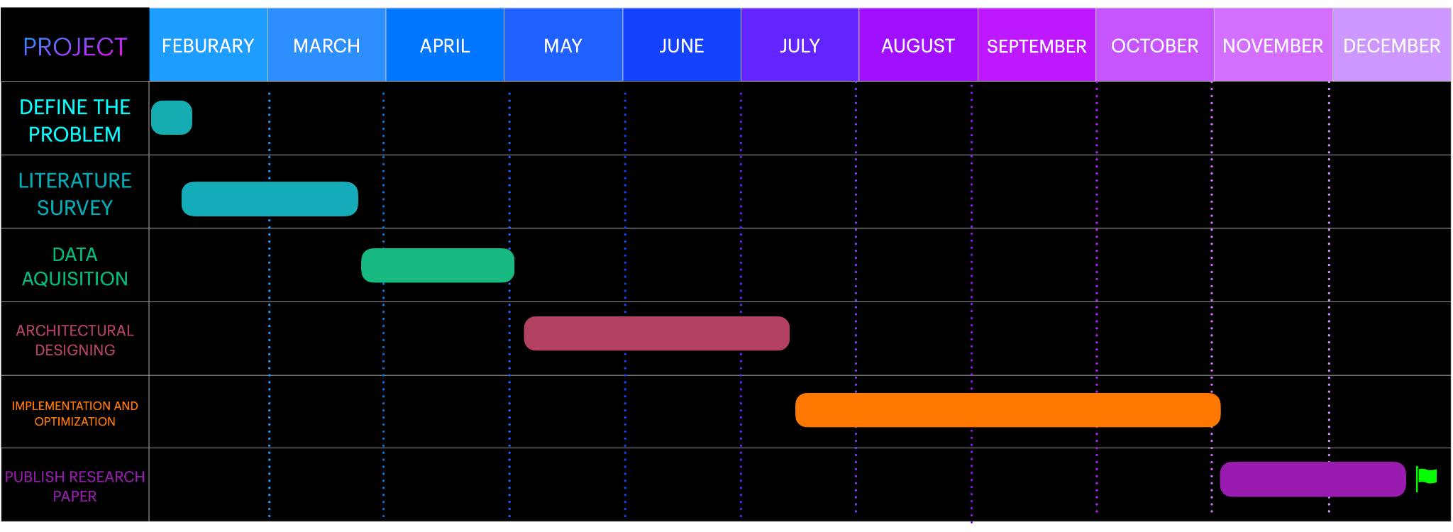
Capstone (Phase-I & Phase-II) Project Timeline
GANTT CHART

Slide 33
Capstone (Phase-I & Phase-II) Project Timeline
The plan in terms of efforts by individuals in the team:
Everyone will participate in pair programming
Everyone will be doing their individual research and will be briefing everyone about it.

Slide 34
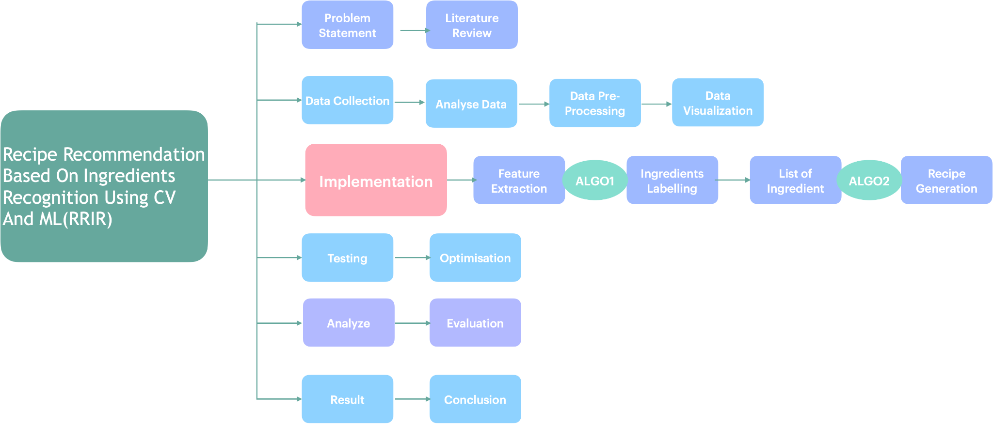
Capstone (Phase-I & Phase-II) Project Timeline

Slide 35
References
Keiji Yanai, Takuma Maruyama, Yoshiyuki Kawano, “A Cooking Recipe Recommendation System with Visual Recognition of Food Ingredients”, 2014
Gangothri R. Sanil , Anusha Anchan , Vijetha Achar, Kavya Hegde, “KNN based Recipe Retrieval using Ingredient Recognition”, 2018
http://users.encs.concordia.ca/~eshihab/teaching/slides/srs_template_sep14.pdf
https://www.toptal.com/designers/ui/ui-styleguide-better-ux
https://www.interaction-design.org/literature/topics/ui-design

Slide 36
Conclusion
Computer Vision - Object detection is a computer vision technique that allows us to identify and locate objects in an image or video. Here, we use a camera to scan the ingredients present in the pantry.
Machine Learning - In machine learning, data labeling is the process of identifying raw data and adding one or more meaningful labels to provide context so that a machine learning model can learn from it. The ingredients scanned by using CV are now labeled using ML models for accurate results .

Slide 37
Conclusion
Search / Web Scraping - The recipe for the list of labeled ingredients obtained from the above steps is searched from the predefined database. If the ingredients do not match with the existing data, web scraping is performed. The list of recipes which meet the requirements are returned to the user, to choose from.
Mobile Application - A simple UI will be created where the user can login and create an account. Once logged in, the user can upload the images of ingredients. These images are processed and the list of suitable recipes are recommended. Additionally, the calories of each recipe will be displayed.

Slide 38
Thank You

